Slide 1
The Nile Valley of Ancient Egypt
Pg. 38-46

Slide 2
Vocabulary
Vocabulary
Cataract-Steep/wild rapids created by cliffs and boulders.
Delta-End of a river that branches out over an area of fertile soil.
Papyrus-Reed like plant that grows along the Nile used to make baskets, sandals, rafts, and paper.
Hieroglyphics-Egyptian writing system using picture and sound symbols.
Dynasty-A line of rulers from one family

Slide 3
Settling the Nile
Between 6000 BC/BCE and 5000 BC/BCE people began to settle the Nile River Valley for its fertile land. They became known as Egyptians.
(What time period is this)
A Mighty River
Area lacks rainfall, so the Nile River is relied on.
It was used for drinking, bathing, irrigation, cooking. Provided fish and supported plant and animal life.
Egyptians view the Nile as a precious gift.

Slide 4
Settling the Nile
Today: World’s longest river, over 4,000 miles long. Flows north from high lands of Central Africa to the Mediterranean Sea.
Much of the Nile is filled with cataracts, narrow cliffs and boulders that form wild rapids.
Large ships only use the last 650 miles of the Nile.

Slide 5
Nile River Cataract

Slide 6
Settling the Nile
A Sheltered Land
The Nile creates one of the largest deltas in the world.
A delta is an area of fertile soil at the mouth of a river.
On both sides of the Nile there is desert.
To the west is the largest desert in the world, the Sahara.

Slide 7
Settling the Nile
To the east is the Eastern Desert.
Deserts served a purpose: Kept enemies out of Egypt.
Other geographic features of protection: Cataracts of the Nile, delta marshes, Mediterranean Sea, and Red Sea.
Nile was/is used for trade and transportation.

Slide 8
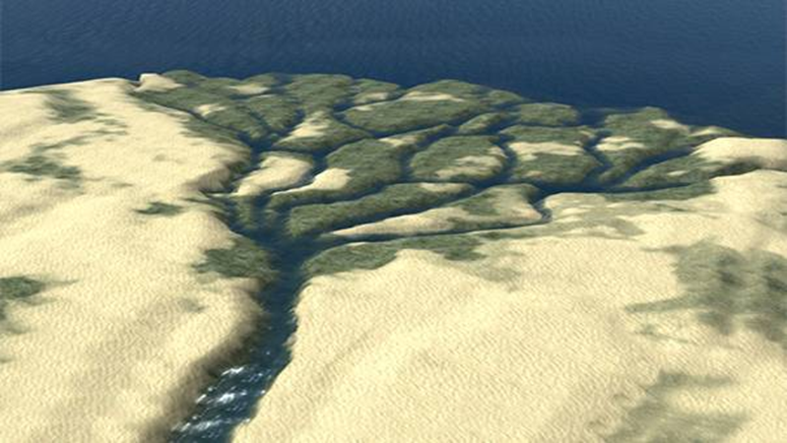
Nile River Delta
Note the branching out!
Why is it GREEN in the delta?

Slide 9
The River People
Regular Flooding
Egyptians had to cope with river flooding.
Floods caused by heavy rains in Central Africa and melting snows in the highlands.
Floods left dark, fertile mud which made the land fertile.
How did Egyptians use the Nile?
Took advantage of floods.

Slide 10
The River People
Planted wheat and barley.
Used the water for irrigation.
Developed geometry to survey land that flood waters washed out.
Used papyrus, a plant along the Nile, to make baskets, and rafts. It was also used as paper.
What are Hieroglyphics?
A way of communication for the Ancient Egyptians.
A creation of picture symbols that stood for sounds and words became known as hieroglyphics.

Slide 11
Papyrus

Slide 12
Paper made of Papyrus

Slide 13
The River People
Few people could read and write in Ancient Egypt.
Those that could were often scribes, or record keepers for the rulers, priests, and traders……just like Mesopotamia.

Slide 14
United Egypt
Skillful farming led to surplus, or extra, which allowed people to work in other areas.
More good became available, resulting in more trade between Egyptians.
Rise of Government
Because of a growth in population and increased disputes of land ownership government had to be formed.

Slide 15
United Egypt
Gradually government grew to overlook the people and decisions to be made.

Slide 16
Early Egyptian Life
Egypt’s Social Classes
Three classes: Upper, middle, and low.
Upper: Priests, government officials, and the wealthy. These people had elegant homes and wore jewelry.
Middle: People who ran businesses, such as farmers, traders, shopkeepers, and scribes.
Low: Unskilled workers, those who unloaded boats, stacked mud bricks, or did physical labor.

Slide 18
Early Egyptian Life
Family Life
Father headed the family.
Egyptian woman had many rights, such as own property, buy/sell goods, and obtain divorces.
Few went to school.
Mothers taught daughters to sew, cook, and run the house.
Fathers taught sons to farm and skilled trades.
Children played with board games, dolls, and stuffed leather balls.

Slide 19
Compare/Contrast
How was/is Ancient Mesopotamia and Ancient Egypt similar? Give some examples.
How was/is Ancient Mesopotamia and Ancient Egypt different? Give some examples.

